Slide 1
Keylogger with Real-Time Keystroke Capture and Logging -ANANYA K A

Slide 2

Agenda
I. Project Initiation
II. Development Phase
III. Testing and Refinement

Slide 3
AGENDA
I. Initiation: Planning the Keylogger
Define goals (e.g., monitor productivity, analyze user experience).
Consider ethical implications and user consent.
II. Development: Building the Keylogger
Choose libraries (e.g., pynput for keystrokes).
Capture key presses, holds, and releases.
Store data in user-friendly formats (text, JSON).
III. Testing and Refining: Ensuring Accuracy
Thoroughly test with various keystrokes and combinations.
Verify data is logged correctly in chosen formats.
Refine code to address bugs or unexpected behavior.

Slide 4

PROBLEM STATEMENT The Problem: Unveiling the Mystery of User Actions 1.Difficulty in directly observing user thought processes 2.Limited understanding of user interactions with complex systems 3.Need for data-driven insights to optimize user experience

Slide 5

Project Overview
1.Captures keystrokes in real-time
2.Stores data in user-friendly formats (text files, JSON)
3.Offers detailed information (pressed keys, timestamps)

Slide 6
The End Users
User Experience (UX) Designers: Optimize website and application usability based on user interaction patterns
Software Developers: Identify areas for improvement in software functionality based on user behavior
Educators and Researchers: Gain insights into student learning processes through keystroke analysis (e.g., typing patterns)
Security Professionals: Monitor potential security threats by tracking suspicious keystroke combinations

Slide 7

The Value Proposition of This Keylogger
Enhanced User Experience (UX) Design
1.Identify user pain points and optimize workflows based on keystroke patterns.
2.Gain insights into user navigation patterns to streamline website and application interfaces.
3.A/B test different design elements by analyzing user interaction with each variation.
Improved Software Development
1.Identify areas for bug fixes and feature enhancements based on user behavior.
2.Analyze user interactions with complex features to improve usability.
3.Gain insights into user expectations for new functionalities.

Slide 8
The Value Proposition of This Keylogger
Valuable Research and Education Insights
1.Analyze student learning processes through keystroke patterns (e.g., typing speed, accuracy).
2.Track user interactions with educational software to identify areas for improvement.
3.Understand user behavior in online learning platforms to enhance engagement.
Heightened Security Measures
1.Monitor for suspicious keystroke combinations that might indicate unauthorized access attempts.
2.Identify potential malware or keyloggers by analyzing unusual keystroke patterns.
3.Enhance overall system security by providing an additional layer of monitoring.

Slide 9
The Wow Factor: Real-Time Insights and Customization
Real-Time Data Analysis
Gain immediate insights into user behavior as actions unfold.
Respond to user needs and identify issues promptly.
Proactive approach to user experience optimization. Anticipate common questions
Customizable Data Capture
Tailor data capture to specific needs.
Focus on capturing keystrokes relevant to your area of interest.
Reduce data overload by filtering out irrelevant keystrokes.
Enhanced Security Monitoring
Set up real-time alerts for suspicious activity.
Respond to security threats immediately.
Mitigate potential damage from unauthorized access attempts.

Slide 10
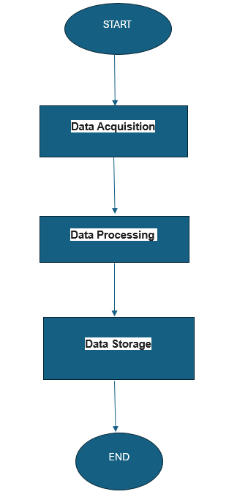
Modelling

Slide 11
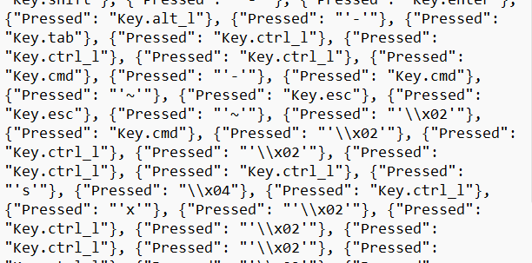
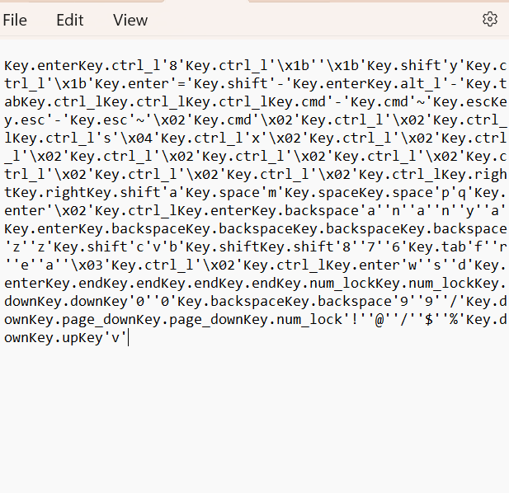
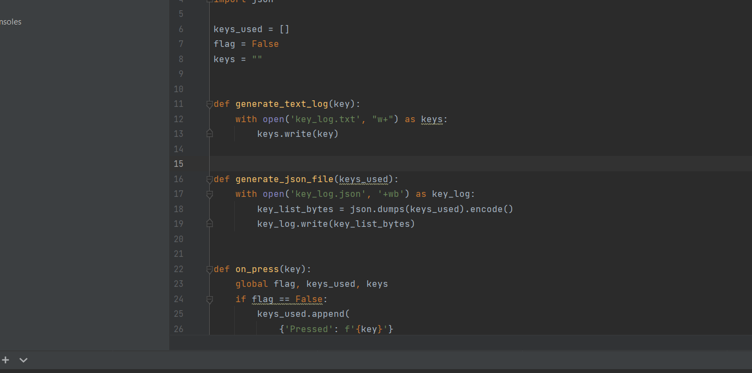
Modelling

Slide 12
RESULTS
1.Real-Time Insights: Gained valuable data on user behavior as actions unfold.
2.Improved User Experience (UX): Identified user pain points and optimized workflows based on keystroke patterns. Enhanced Software Development: Identified areas for bug fixes and improved features based on user interaction data.
3.Valuable Research & Education Insights: Analyzed student learning processes and user interactions with educational software.
4.Heightened Security Measures: Monitored for suspicious keystroke combinations and identified potential malware/keyloggers.

Slide 13
Thank you
Ananya K A B. Tech IT
2021115013
CEG, Anna University

